Slide 1

Distributed Deadlock Detection Algorithms
BY
19125025 Krishn Odedara
19125036 Riya Hemrajani

Slide 2
What is Deadlock
Dead lock is a state where a process may ask for resources which are held by other processes

Slide 3
Assumptions for a Distributed systems
The systems have only reusable resources.
Processes are allowed to make only exclusive access resources.
There is only one copy of each resource.
A process can be in two states: running or blocked.
In the running state (also called active state), a process has all needed resources and is either executing or is ready for execution
In the blocked state, a process is waiting to acquire some resources

Slide 4

How We Detect Deadlock in a Distributed systems

Slide 5
The Wait For Graph
We can represent a state of a processor with a Graph data structure called wait for graph

Slide 6
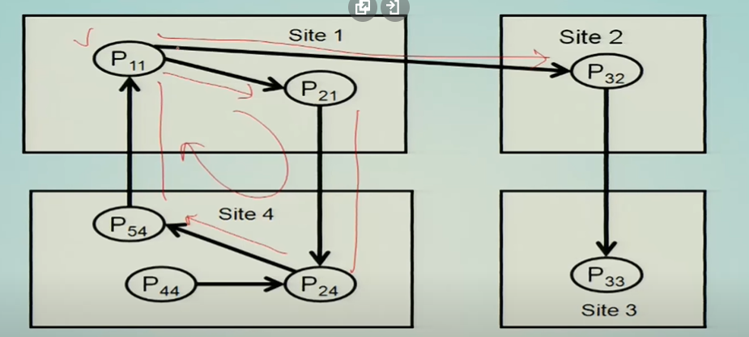
What is wait For Graph Data structure
In wait for graph data structure we are having all the processors as represent as node and there is a edge between node 01 --> node 02 if noted 01 is waiting for a node 02 to release some resources and we can say that the system is in dead lock if there is a cycle which is forming in the graph

Slide 7
Strategies for Dead lock Detection
Dead lock Avoidance
Dead lock handling
Dead lock prevention
Dead lock Detection

Slide 8
Dead lock Handling
In the Deadlock Handling is a very complex process because Distributed systems don't have a full knowledge of the global system and systems don't have a common physical clock so not good for DS

Slide 9
Dead lock prevention
In Dead lock prevention what we are trying to do is a process will take all the resources before it starts executing all preempt any process who is holding a resource which is needed by the process, and this is not possible.

Slide 10
Dead lock Detection
Deadlock detection requires examination of the status of process resource interactions for presence of cyclic wait.
Dead lock Detection is the best method

Slide 11
Dead lock avoidance
The resource will only be allocated if the final state will not result in a deadlock.
We can solve this deadlock by using Bankers Algo. which is also used for deadlock detection.

Slide 12
Requirements that ever algorithm should follow
Progress
All the dead locks should be detected by any algorithm
Safety
No false deadlock should be detected by an algorithm
A false deadlock detected by the algorithm is known as phantom dead lock

Slide 13
Models of Dead lock

Slide 14
One resource model
In this model each process is allowed to have only one outstanding resource request since the maximum degree of node in 01 then WSG will identify a dead lock as soon as it arises

Slide 15
And model
In and model a process can request for multiple number of resources and all the request are satisfier only when all the requested resources are available at the same time

Slide 16
And Or Model
And or model is a generalization of the 2 models and or model and or model a request may specify any combination of AND or in the request resource. For example, in AND OR model a request for multiple resources can be of the form x, y or z to detect the presence of a deadlock in such a model there is no familiar construct of a graph theory for that use, the wait for graph hence the deadlock is detected using its stable property. So, a deadlock in AND OR model can be directed by repeated application of the test for the or model

Slide 17
P out of Q model
Now, another model is called P out of Q modeless, another form of and or model is called P out of Q model which allows the process to request any k available resources from a pool of n resources it has same expressive power as at as and or model we have seen earlier; however, P out of Q model lends itself to a much more compact formation of a request. So, every request in a P out of Q model can be expressed in the form of AND OR graph and vice versa note that and requests for P resources can be stated as P out of P; that means, all P resources are required that is the AND model and the OR model request for the P resources can be stated as 1 out of P that is an OR model. So, P out of Q can be expressed in these 2 forms of OR and n

Slide 18
Classification of deadlock Detection algorithm
Path pushing
Edge chasseing
Diffusion computation
And global state detection-based algorithm

Slide 19
Path pushing
In this algorithm a global WFG is mittened and when any process ask for a resource at that time it will send its current state to all the node and this process is continues until any one node don't have the full picture of a Distributed system and once a full picture is established at that time one node will asses the scenario and decide whether dead lock is present in the system or not

Slide 20
Edge Chasseing
In the Edge chasseing algorithm, a probe is sent to all the system and if any system which is currently exciting will reject the probe and continue its execution hence if any process will accept the probe, then it is decided that a cycle is there in the DS the benefit of this system is that the size of a probe is smaller so the overhead on the system is less

Slide 21
Diffusion computation
In diffusion computation based distributed deadlock detection algorithms, deadlock detection computation is diffused through the WFG of the system. These algorithms make use of echo algorithms to detect deadlocks. This computation is superimposed on the underlying distributed computation. To detect a deadlock, a process sends out query messages along all the outgoing edges in the WFG. When a blocked process receives first query message for a particular deadlock detection initiation, it does not send a reply message when the inspector will not receive the reply from all the node hence it conclude that a dead lock is accrued in the system

Slide 22
Global State Detection Based Algorithms
Global state detection-based deadlock detection algorithms exploit the following facts:
1.A consistent snapshot of a distributed system can be obtained without freezing the underlying computation and
2.If a stable property holds in the system before the snapshot collection is initiated, this property will still hold in the snapshot.
• Therefore, distributed deadlocks can be detected by taking a snapshot of the system and examining it for the condition of a deadlock

Slide 23

Thank you

